Slide 1


Maulana Azad National Institute of Technology , Bhopal
Department of Mathematics, Bioinformatics and Computer Applications​​
Fire Fighting Robot with SMS and Call alert….
Presented By :
Hitesh Yadav (212120145)
Abhinav Mishra (212120014)
Aakash Shukla(212120113)
Nitesh Aggarwal(212120147)
MCA 4th Sem
Guided By :
Prof. Geetanjali Nenvani

Slide 2
Project Overview
The project aims to build an autonomous “Fire Fighting Robot” that can detect and extinguish fires in a given area. The robot will be equipped with sensors to detect fire and an Arduino microcontroller to process sensor data and control the robot's movement and firefighting mechanisms. Additionally, the robot will be connected to the Internet of Things (IoT) and be able to send call and SMS alerts to designated recipients in case of an emergency.

Slide 3
Project Objective
Design and develop an Arduino-based fire-fighting robot with sensors to detect fire.
Implement a mechanism to control the movement of the robot towards the fire.
Develop a fire extinguishing mechanism that can be controlled by the robot.
Integrate a GSM module to send SMS and call alerts in case of fire.
Test the robot in a safe environment to ensure it operates effectively.

Slide 4
Real Life Applications of Our Project
The project "Fire Fighting with SMS and Call Alert" is an IoT-based system that uses sensors to detect fires and alerts emergency responders via SMS and phone calls. This project has several real-life applications in the following industries:-
Home Automation: This project can be used in homes to alert residents of fires and smoke. The system can also automatically turn off appliances and electronics to prevent the spread of fires.
Industrial Safety: In industries, such as factories and warehouses, where there is a high risk of fires, this system can be used to detect and alert workers of any potential fire hazards. It can also trigger the activation of sprinkler systems and emergency protocols.
Public Safety: This project can be implemented in public buildings, such as schools, hospitals, and government offices, to detect and alert occupants of any potential fires. It can also automatically notify emergency services to quickly respond to the situation.
Forest Fire Prevention: This project can be used in forest areas to detect and alert forest rangers of any potential fires. It can also help prevent the spread of fires by triggering the activation of sprinklers and water pumps.

Slide 5
Hardware Requirements
Arduino UNO R3
SIM800L GSM Module
Flame Sensor
MQ2 Sensor
L293 Motor Driver
Relay Module
LM2596 Buck Converter
Servo sg 90
Mini Water Pump (5v)
BO Motor, Wheel
18650 Battery
Mini Breadboard
Jumper Wire
Cardboard

Slide 6
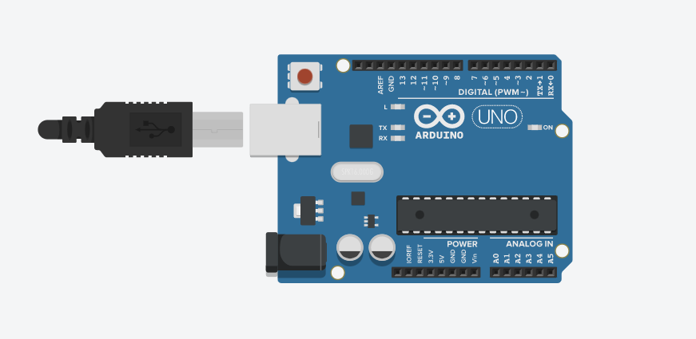
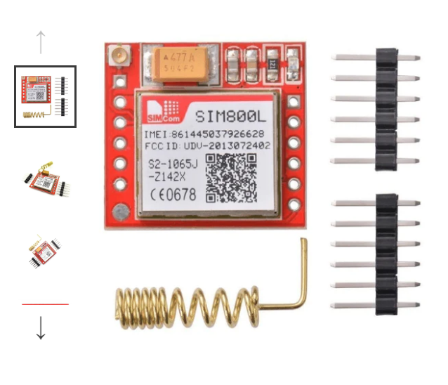
Arduino UNO R3
Arduino Uno R3 is a microcontroller board based on the ATmega328P with 14 digital input/output pins, 6 ana log inputs, a 16 MHz quartz crystal, USB connection, power jack, and ICSP header
SIM800L GSM Module
The SIM800L is a GSM/GPRS module that allows the Arduino or any microcontroller to make voice calls, send SMS messages and connect to the internet through GPRS. It operates at a frequency of 850/900/1800/1900MHz and has a serial communication interface for easy integration with microcontrollers

Slide 7
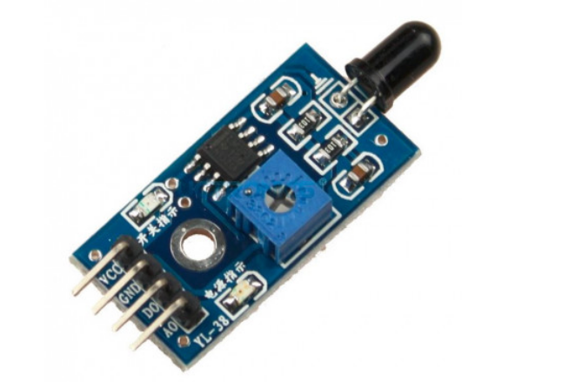
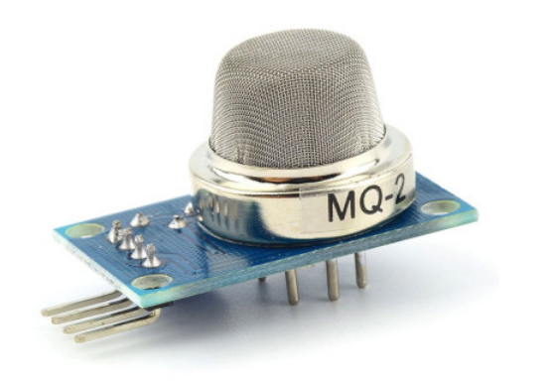
Flame Sensor
A flame sensor is an electronic device that can detect the presence of a flame or fire by sensing the infrared radiation emitted by the flames
MQ2 Sensor
The MQ2 gas sensor is a module used for gas detection, particularly for detecting smoke and flammable gases. It has a high sensitivity to propane, butane, and methane and can be used in home and industrial applications for fire detection and gas leakage monitoring. It uses a simple analog output that can be read by a microcontroller to trigger alarms or control other devices

Slide 8
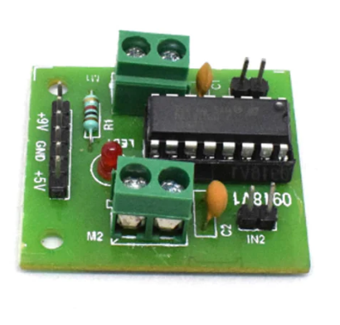
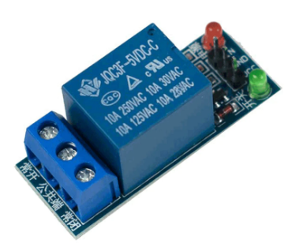
L293 Motor Driver
The L293 motor driver is an integrated circuit that can drive two DC motors in both directions or one stepper motor with bi-directional control. It can handle a maximum voltage of 36V and a maximum current of 600mA per channel. It is commonly used in robotics and other projects that require motor control.
Relay Module
A relay module is an electronic device that allows you to control high-power circuits using low-power circuits. It works by using an electromagnet to switch the high-power circuit on or off based on the state of the low-power circuit. It is commonly used in home automation, robotics, and other projects that require high-power switching

Slide 9
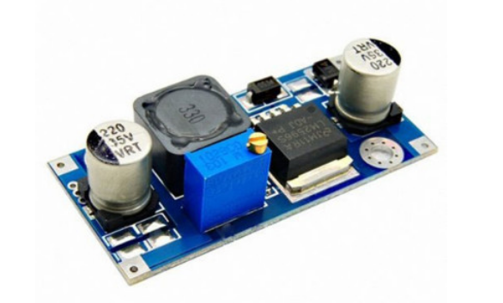
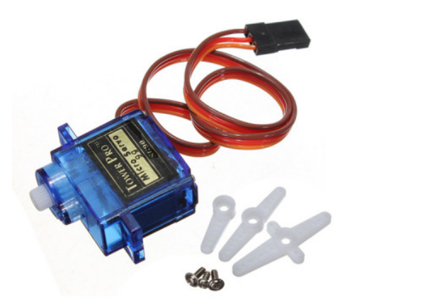
LM2596 Buck Converter
The LM2596 is a buck converter IC that can efficiently step down a higher input voltage to a lower output voltage with the help of an inductor, capacitor, and a few other passive components.
Servo sg 90
SG90 is a type of small-sized, low-cost servo motor commonly used in hobbyist and educational robotics projects.

Slide 10
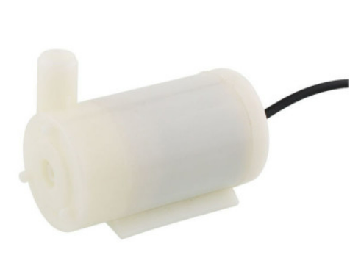
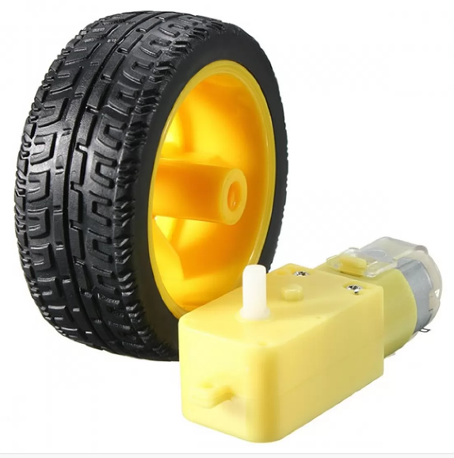
Mini Water Pump (5v)
A 5V mini water pump is a small, compact pump designed for low flow-rate water transfer applications, typically powered by a 5V power supply.
BO Motor, Wheel
A DC brushless motor, also known as a "bo" motor, is often used in conjunction with a wheel to create a motion system in robots, electric vehicles, and other applications where high torque and precise control are needed.

Slide 11
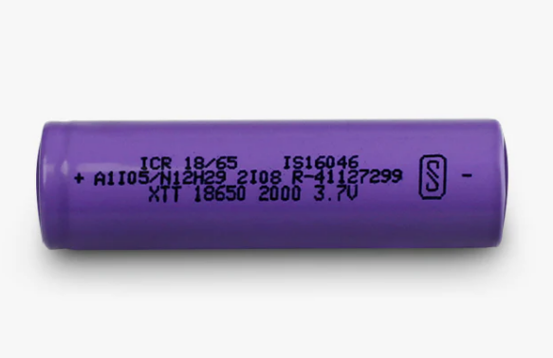
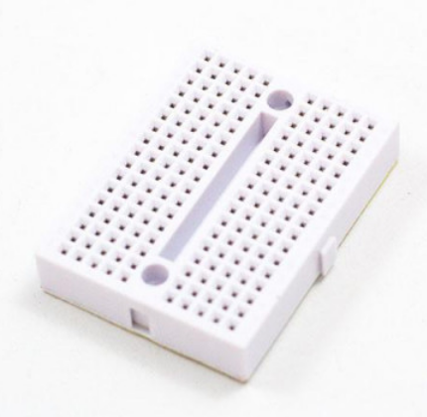
18650 Battery
The 18650 battery is a type of lithium-ion rechargeable battery commonly used in portable electronic devices, power banks, and electric vehicles due to its high energy density and long-lasting performance.
Mini Breadboard
A mini breadboard is a small electronic prototyping board used for creating and testing circuits with a limited number of connection points

Slide 12
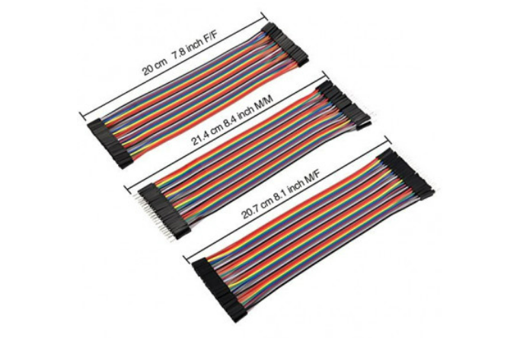
Jumper Wire
A jumper wire is a thin insulated wire used to connect two points on an electronic circuit or breadboard.

Slide 13
Project Flow:
The robot will be designed and assembled using the hardware requirements mentioned above . The Arduino microcontroller will be programmed to process data from the ultrasonic and flame sensors and control the robot's movements and firefighting mechanisms.
When a fire is detected, the robot will move towards the source of the fire and spray water using the water pump and nozzle to extinguish the flames .
The GSM module will be used to send call and SMS alerts to designated recipients when a fire is detected. The recipients' phone numbers will be stored in the Arduino code.
The robot will continue to move around the area and search for any other fires to extinguish . Once all fires have been extinguished, the robot will return to its starting position and await further instructions.

Slide 14
Block Diagram
GSM Module
Right DC
motor
Smoke sensor
ARDUINO
UNO
L293 Motor
Driver
IR Flame sensor
Left DC
motor
Servo motor
Fire Extinguisher
Power supply
7.4V Supply
Power supply

Slide 15
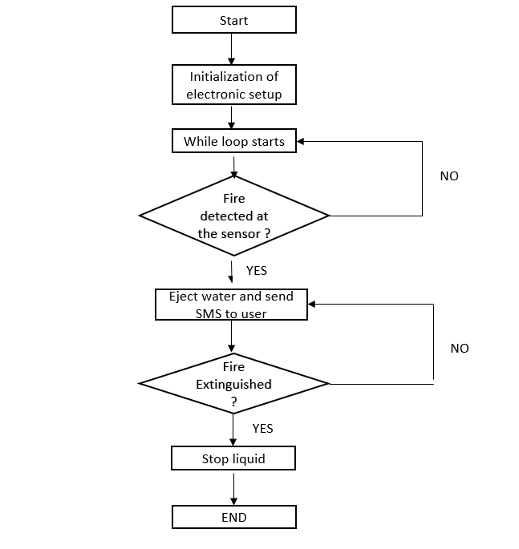
Flow Chart

Slide 16
Code
#include <Servo.h> //include servo.h library
#include <SoftwareSerial.h> //include SoftwareSerial.h library
Servo myservo;
int pos = 0;
bool fire =false;
#define rxPin 2
#define txPin 3
SoftwareSerial sim800L(rxPin,txPin);
#define Right 4 // left flame sensor
#define Left 5 // right flame sensor
#define Forward 6 //front flame sensor
#define GAS_SENSOR 7 //Gas sensor
#define LM1 8 // left motor
#define LM2 9 // left motor
#define RM1 10 // right motor
#define RM2 11 // right motor
#define pump 12 //water pump

Slide 17
void setup()
{
Serial.begin(115200);
sim800L.begin(9600);
pinMode(Left, INPUT);
pinMode(Right, INPUT);
pinMode(Forward, INPUT);
pinMode(GAS_SENSOR, INPUT);
pinMode(LM1, OUTPUT);
pinMode(LM2, OUTPUT);
pinMode(RM1, OUTPUT);
pinMode(RM2, OUTPUT);
pinMode(pump, OUTPUT);
myservo.attach(13);
myservo.write(90);
digitalWrite(pump,LOW);
}

Slide 18
void loop()
{
myservo.write(90); //Sweep_Servo();
if (digitalRead(Left) ==1 && digitalRead(Right)==1 && digitalRead(Forward) ==1)
{
digitalWrite(LM1, HIGH);
digitalWrite(LM2, HIGH);
digitalWrite(RM1, HIGH);
digitalWrite(RM2, HIGH);
digitalWrite(pump,HIGH);
}
else if (digitalRead(Forward) ==0)
{
digitalWrite(LM1,HIGH);
digitalWrite(LM2, LOW);
digitalWrite(RM1, HIGH);
digitalWrite(RM2, LOW);
fire =true;
}

Slide 19
else if (digitalRead(Left) ==0)
{
digitalWrite(LM1, HIGH);
digitalWrite(LM2, LOW);
digitalWrite(RM1, HIGH);
digitalWrite(RM2, HIGH);
}
else if (digitalRead(Right) ==0)
{
digitalWrite(LM1, HIGH);
digitalWrite(LM2, HIGH);
digitalWrite(RM1, HIGH);
digitalWrite(RM2, LOW);
}

Slide 20
delay(400);//change this value to change the distance
if(digitalRead(GAS_SENSOR)== 0)
{
Serial.println("Gas is Detected.");
send_sms();
}
if(fire==true)
{
put_off_fire();
make_call();
Serial.println("Fire Detected.");
}
}

Slide 21
void put_off_fire()
{
digitalWrite(LM1, HIGH);
digitalWrite(LM2, HIGH);
digitalWrite(RM1, HIGH);
digitalWrite(RM2, HIGH);
delay(500);
digitalWrite(pump,LOW);
for (pos = 50; pos <= 130; pos += 1) {
myservo.write(pos);
delay(10);
}
for (pos = 130; pos >= 50; pos -= 1) {
myservo.write(pos);
delay(10);
}
digitalWrite(pump,HIGH);
myservo.write(90);
fire=false;
}

Slide 22
void make_call()
{
sim800L.println("ATD+917310019508;"); // replace with the phone number
delay(10000); // wait for 10 seconds or until the call is disconnected
sim800L.println("ATH"); // hang up the call
}
void send_sms()
{
sim800L.println("AT+CMGF=1"); // set SMS text mode to plain text
delay(1000);
sim800L.println("AT+CMGS=\"+917310019508\""); // replace with the phone number
delay(1000);
sim800L.print("Fire Detected");
delay(1000);
sim800L.write(0x1A);
delay(5000); // wait for module to send the message
}

Slide 23
Problem Faced
After fixing the tyre and soldering the wire and attach the wire to motor driver after uploading the code we found that when the fire is left it goes to right & when the fire is on right then it goes to left so we change the pins in our code.
Pump motor automatically start because Relay Module default initialize to High so relay automatically complete the circuit due to which it run out water from starting by observation we correct it & initialize to low.
We do not known how to set the voltage of buck converter due to so we want took the help of someone, but no one knows how to set the dc voltage. Due to lack of setup of buck converter we are not able to add the functionality of calling so we take the reference from Google as well as YouTube and we find how to setup voltage using buck converter.
Sim module not able to make a call as well as not able to send the message so we change its code again and again and after study we find that its work with 2g sim And so we change sim card use the appropriate code as well as we change RX & TX pin’s of arduino to pin 2 and pin 3 because due to which we are not able to upload the code.

Slide 24
Project Outcome
The fire fighting robot with call and SMS alert IoT project aims to provide an effective solution for extinguishing fires in a given area. The robot's autonomous nature, combined with its ability to send real-time alerts to designated recipients, will help to minimize the damage caused by fires and prevent loss of life. Additionally, the project will serve as a valuable learning experience for those interested in robotics, IoT, and programming.

Slide 25
Conclusion
The Arduino fire-fighting robot with SMS and call alert will provide an effective solution to detect and extinguish fires in a safe and efficient manner. This project will utilize the latest technologies in IoT and robotics to create a useful and practical device that can potentially save lives and property

Slide 26
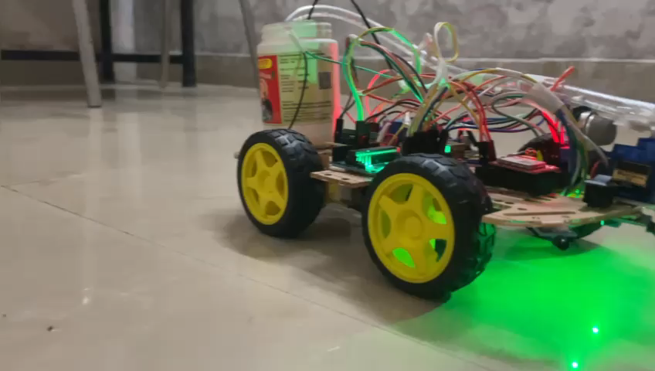

Slide 27


